Slide 1
CRUD Based Application using HTML, CSS & JS
Mentor
Presented By-
Mrs. Nidhi Chandrakar
Jeet Verma

Slide 2
Introduction
The simple Phone number book is a simple personal diary-like system. The whole programming is in HTML, CSS, and JavaScript. This project will help the users to keep track of friends and family by managing in your contact list. You can simply use any kind of code editor for this project. I’ve used Brackets editor and Sublime Text editor. This is a simple yet complete contact manager web application.
The phone book keeps a track record of colleagues. It is lightweight HTML based program for personal contact manager in the web version. To run this project, first, you need to have a browser and a code editor of any kind. Then you have to run the “index.html” file from the editor or directly from the folder. When the screen loads, you can see the homepage.

Slide 3
Working block Diagram :
Admin is registered
Admin login i’d and & password
Check I’d password
Invalid login I’d/password
Login successfully
Perform operation
Logout

Slide 4

The Login page :

Slide 5
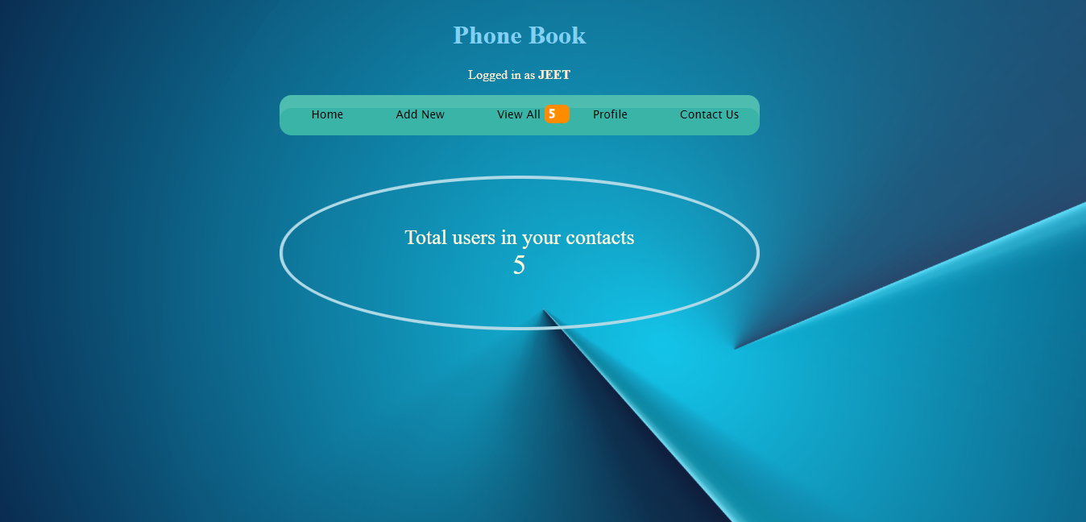
Snapshot of Home page :

Slide 6
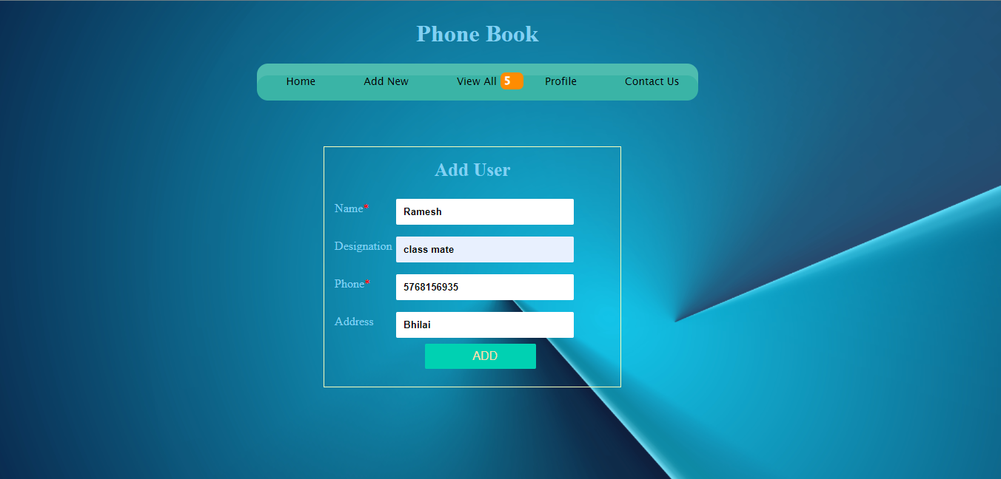
We need to fill required fields to add a Contact :

Slide 7
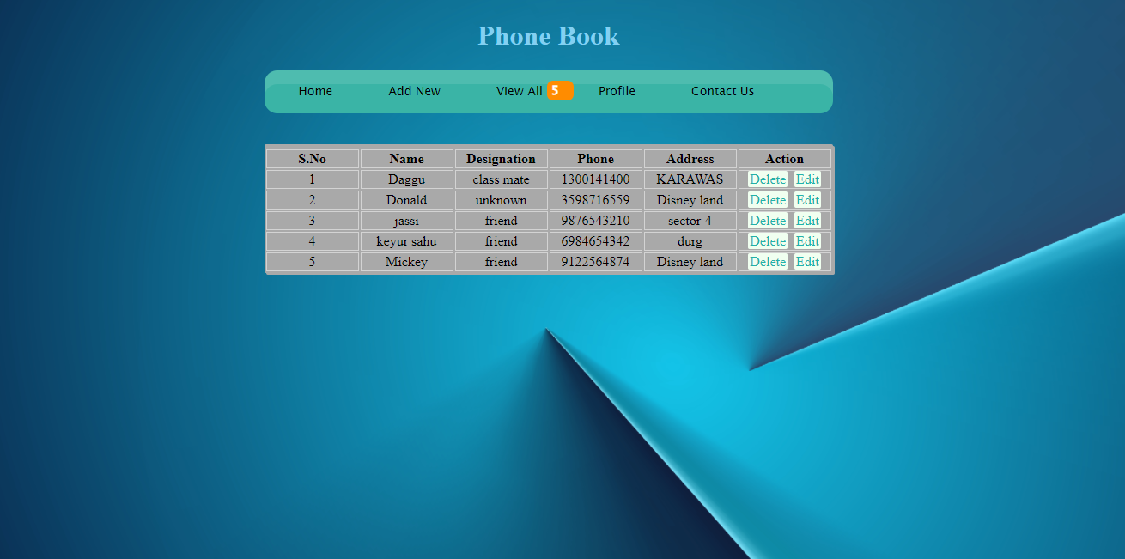
After clicking the ‘add’ button, the contact has been added successfully and we can edit contact :

Slide 8
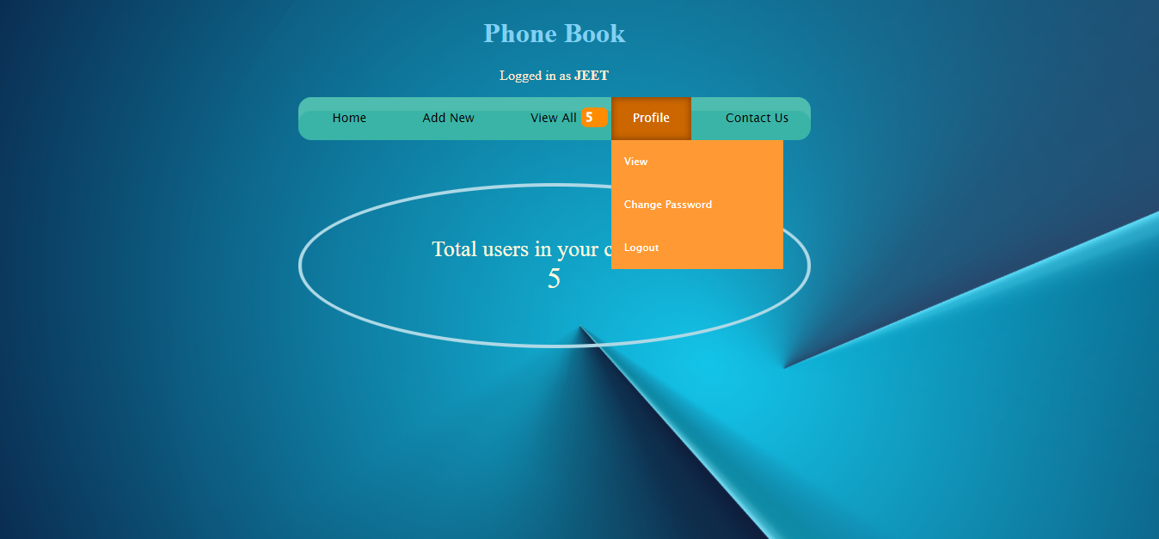
In this Profile button we can change password, logout and see user information :

Slide 9
Conclusion
With the use of this phonebook program we can keep contact archives of our family members, friends, etc.
We would no longer be needed to make spread sheets, tables etc. just to store phone numbers.
We can always see the phone numbers on our desktops.
This program is based upon simple HTML, CSS and Javascript codes and thus is simple to understand and comprehend.

Slide 10
Thank You

